Slide 1


METAPHOR SHIFTS IN CONSTRUCTIONS:
THE RUSSIAN METAPHOR CORPUS
Yulia Badryzlova, Olga Lyashevskaya
MARCH 28, 2017
Notes:
1. Dear colleagues,
My name is Yulia Badryzlova, I am happy to speak to you toady, and my presentation is devoted to metaphor shifts in constructions as observed in the Russian metaphor-annotated corpus.

Slide 2


National Research University Higher School of Economics
School of Linguistics
Moscow, Russia
YULIA BADRYZLOVA
PhD Student
OLGA LYASHEVSKAYA
Professor
Notes:
2. My co-author Olga Lyashevskaya and I work at the School of Linguistics of the Higher School of Economics in Moscow, Russia.
To our utter regret, we cannot be with you in person today, so greatly appreciate the opportunity to communicate with you by means of this online presentation.

Slide 3

CREMe: THE EXPERIMENTAL RUSSIAN METAPHOR CORPUS
Notes:
3. The title of our project is “CREMe”, which is a frivolous acronym of “The Experimental Russian Metaphor Corpus”.
This is an ongoing project, so we will not report any quantitative results; rather, we will present the scheme the we offer for the annotation of metaphor, as metaphor annotation is by far not a trivial task.

Slide 4
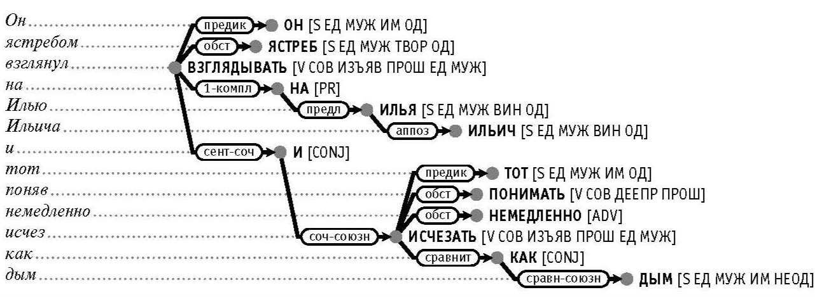
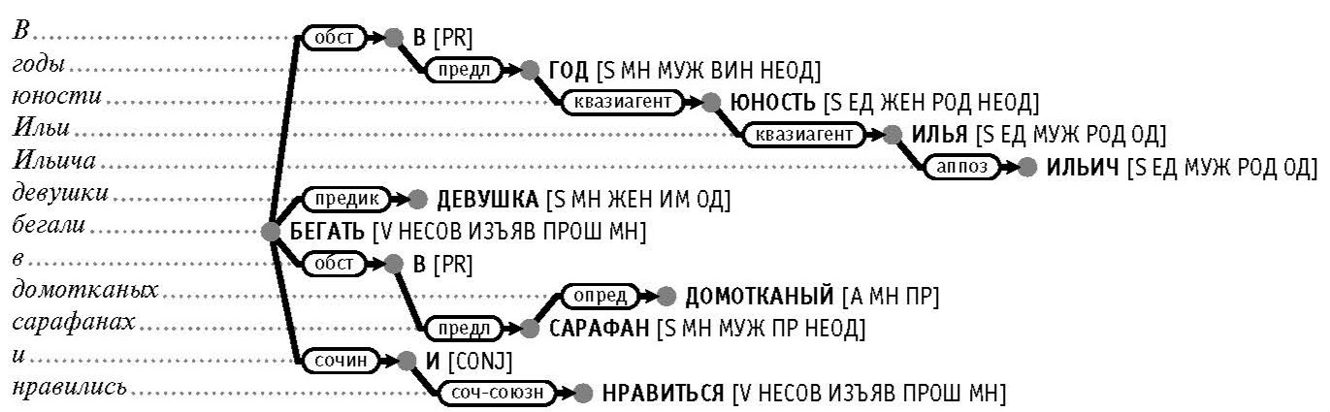
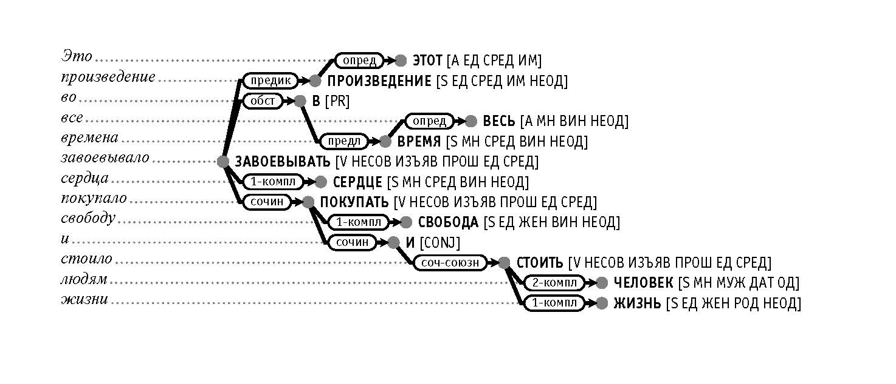
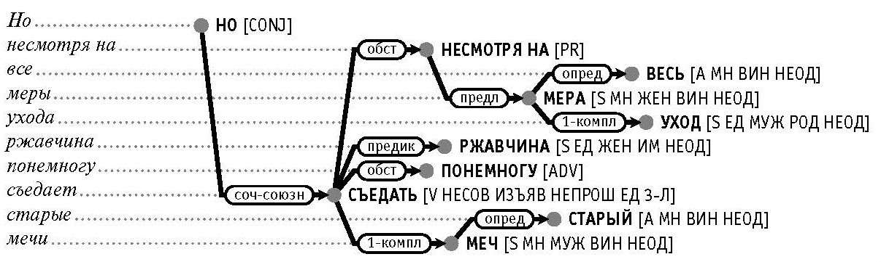
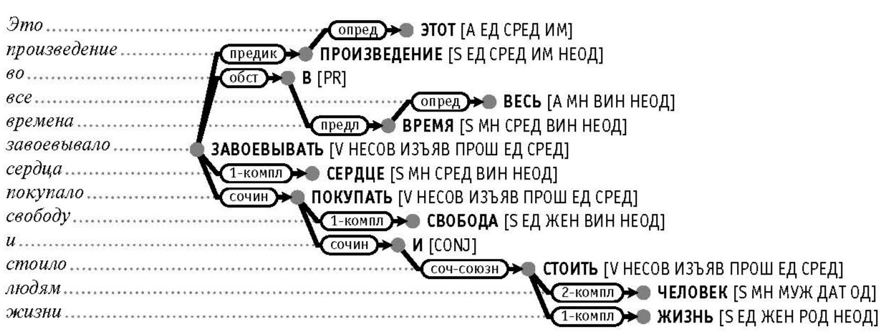
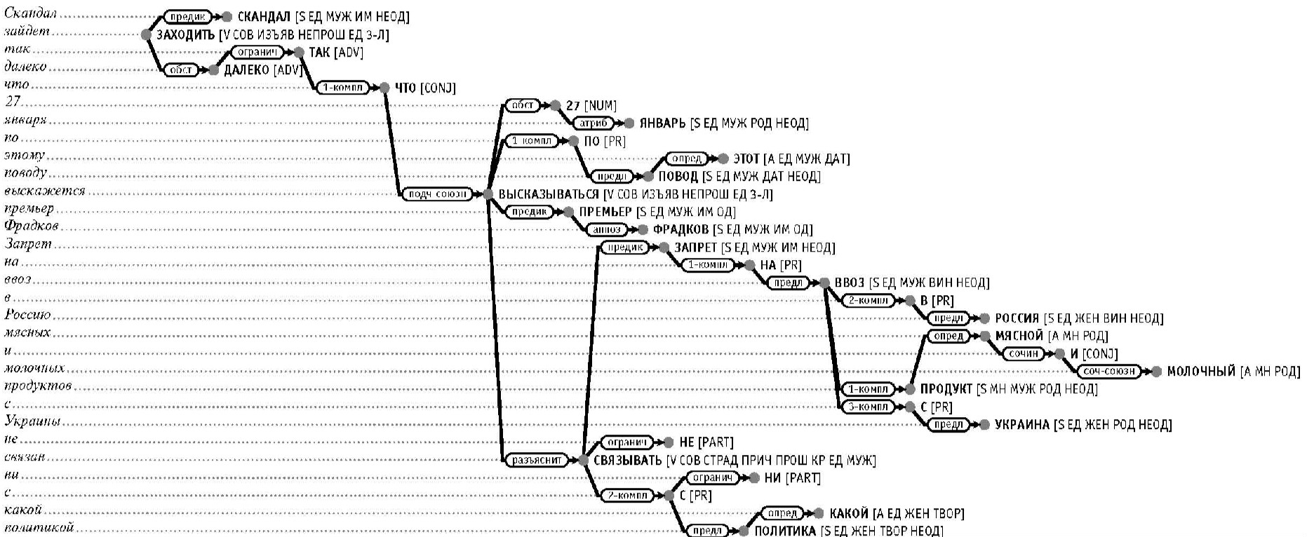
SynTagRus
SYNTACTICALLY AND SEMANTICALLY ANNOTATED
RUSSIAN CORPUS
≈ 1m tokens
69 types of dependency relations
Full morphological information
84 types of lexical functions (collocates)
hand-corrected
Notes:
4. What we do is: we annotate metaphor on a corpus that contains rich and high-quality morphological, syntactic and semantic markup, which allows us to observe the behaviour of constructions in metaphoric occurrences.
SynTagRus comprises approximately 1m tokes with full morphological information, including (non-)animacy of nominal forms (which is their inherent morphological feature in Russian).
The syntax in SynTagRus is annotated with 69 types of dependency relations: predicative, agentive, quasi-agentive, first complement, modifier, and prepositional, and others.
Besides, SynTagRus contains annotation of 84 types of collocates (or Lexical Functions). For example, the lexical function OPER 1 in ‘osuschestvlyat’ (v, exercise) + ‘kontrol’ (n, control) denotes a semantically empty verb such that the first actant of a certain situation functions as the subject of this verb and the name of the situation itself is the verb’s first object.
SynTagRus is recognized as a golden standard of Russian syntactic annotation because its initial automatic parsing was manually checked and corrected by linguists.
See [12, 13]

Slide 5
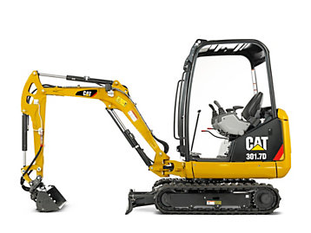
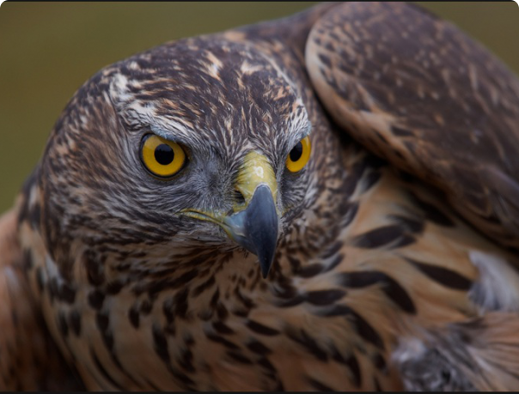




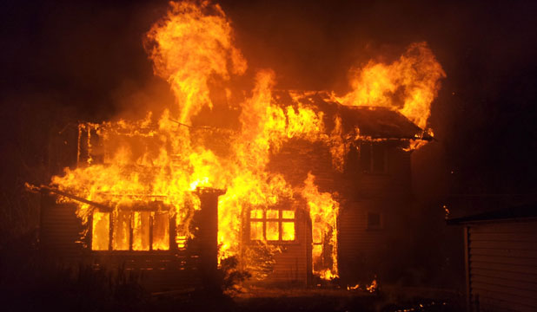
ANNOTATING
METAPHOR
Notes:
5. Our aim in annotating metaphor is to capture a variety of types of metaphor and the factors that contribute to metaphoricity, and their dynamic interactions in dicsourse.
We annotate the three major types of metaphor: Indirect Metaphor, Personification, and Direct Metpaphor.
The additional factors of metaphoricity annotated in the corpus are: the shift of the semantic class of the argument between Concrete and Abstract, metonymic shifts, newly attested meanings, morphologically motivated forms and semantic shifts.

Slide 6
INDIRECT METAPHOR
MIPVU
BASIC MEANING
CONCRETE
BODILY-ORIENTED
PRECISE
CONTEXTUAL ≠ BASIC
Notes:
6. The first type of metaphor we annotate is Indirect Metaphor (this is a term borrowed from MIPVU, the Vrije University Metaphor Identification Procedure, proposed by G. Steen et al [5].)
Basically, Indirect Metaphor is another term for conventional lexicalized metaphor.
For each word in a sentence, we establish its Basic Meaning(s) (BM) and Contextual Meaning.
The BM is the most concrete, bodily-oriented and precise meaning of the word. The remaining meanings that are less concrete, bodily-related and precise are Non-Basic Meanings (NBM).
Indirect Metaphor is attested when the contextual meaning of a word in a given context is not BM.

Slide 7
DICTIONARY OF BASIC / NON-BASIC MEANINGS
‘Goret’ (V, burn/shine)
be overcome by a strong emotion, passionately devote oneself to smth
be exposed to fire
be destroyed by fire
be burning
(oven etc.)
emit light or fire
be at risk of failure because of a delay or an overdue deadline
glitter with emotion or thought (eyes)
Notes:
7. For example, among the six meanings of the Russian verb ‘goret’ (to burn/to shine), three meanings will be Basic – the ones that relate to emotions and deadlines. Therefore, whenever ‘goret’ occurs in a sentence in one of these meaings, it will be annotated as IndirMet.
We compile a dictionary of word meanings where each meaning is tagged as either BM or NBM (also WIDLII – an acronym borrowed from MIPVU for borderline cases).
Our inventory of word meanings comes from an electronic version of The Dictionary of the Russian Language [15] as the most representative and authoritative dictionary of contemporary Russian.

Slide 8
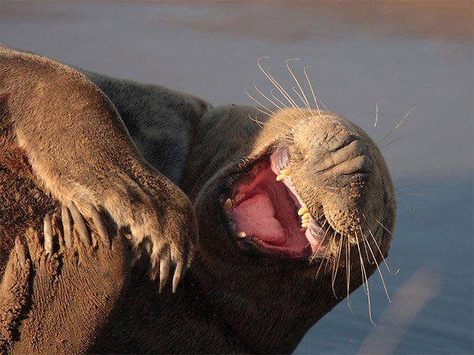
NO POTENTIAL FOR INDIRECT METAPHOR
‘Khokhotat’ (V) – Scream with laughter
BM Laugh loudly
BM Produce sounds resembling laughter
‘Uvazhat’ (V) – Respect
NBM Feel respect or reverence towards smb or smth
NBM Take smth into account or consideration, treat smth with respect
NBM Love and value smth for its qualities
Notes:
8. Lexemes that have only Basic or only Non-Basic meanings cannot produce Indirect Metaphor.

Slide 9
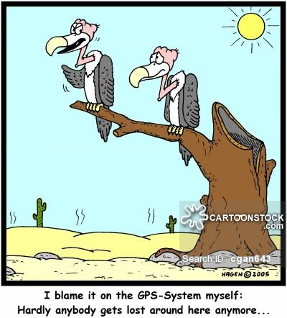
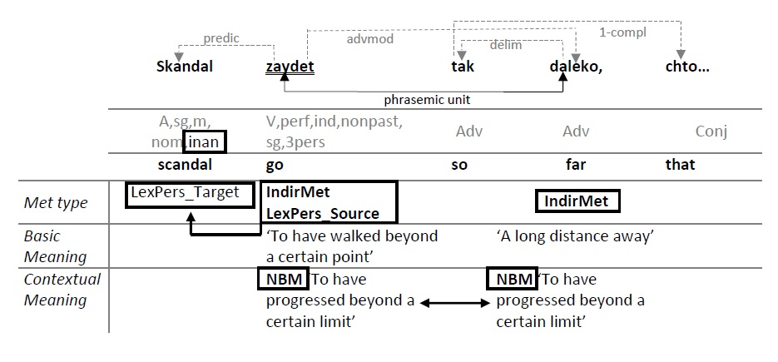
PHRASEMIC UNITS, IDIOMS
‘zayti (V) daleko (ADV)’
to have walked far
Notes:
9. Phrasemic units and idioms are annotated as a subtype of Indirect Metaphor.
In this example, the Non-Basic Meaning of the phrasemic unit ‘zayti (V) daleko (ADV) – to have progressed beyond a certain limit – is opposed to the Basic Meaning of the free word combination made up of the same constituents – to have walked far.

Slide 10
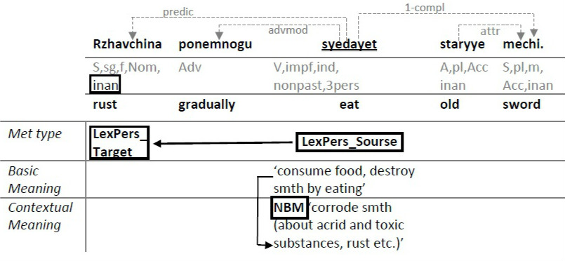
LEXICALIZED PERSONIFICATION
‘Syedat’ (V) – to eat
Rust gradually eats (=corrodes) old swords.
Notes:
10. The second type of metaphor we annotate is Personification – the shift of the argument class from Animate to Inanimate.
Lexicalized Personification is observed when the central BM of a word requires an animate argument, while a dictionary-attested peripheral BM or an NBM requires an inanimate argument.
The word that triggers the shift of the class is called Source of Personification; the inanimate argument that this word takes is called Target of Personification.

Slide 11
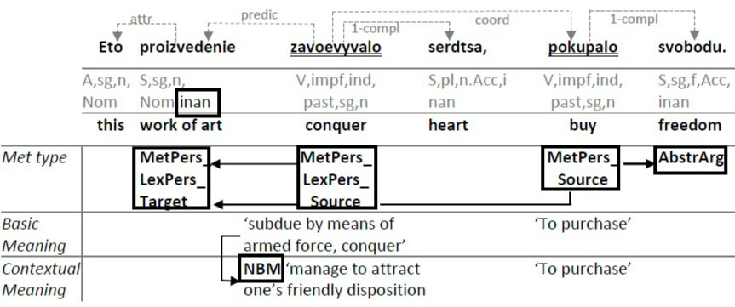
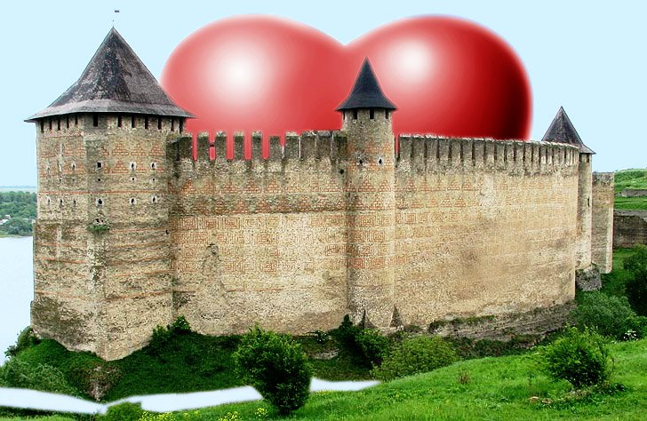
This work of art … conquered hearts, bought freedom.
METAPHORIC PERSONIFICATION
Notes:
11. Metaphoric Personification is observed when the contextual meaning (either BM or NBM) normally requires an animate argument, but takes an inanimate argument instead, as the verb ‘pokupat’ – to conquer – in this example.
(Beside MetPers, this sentence also contains an instance of Lexicalized Personification (triggered by the verb ‘zavoyevyvat’ – to concquer and an instance of the shift from Concrete to Abstract, see Slide 15.

Slide 12

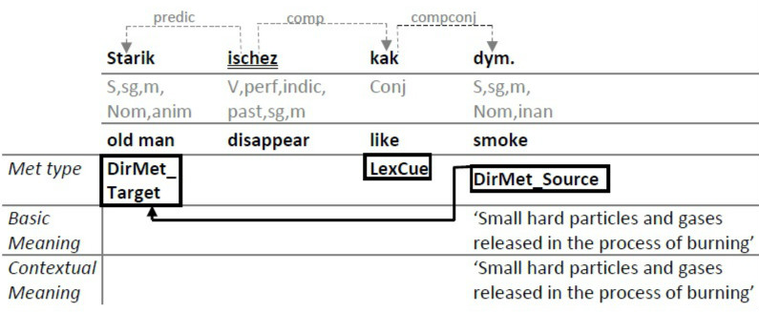
DIRECT METAPHOR
LEXICAL CUE
The old man disappeared like smoke.
Notes:
12. The third type of metaphor we annotate is Direct Metaphor (this term is also borrowed from MIPVU).
Contextual meaning (either BM or NBM) refers to a concept from a different domain than the regular domain of the contextual meaning. In terms of Conceptual Metaphor Theory, there is a mapping between a conceptual Source and a Target domains.
Direct Metaphors can be signaled in the sentence by different cues: graphic, lexical or morphological.
In this example, the Direct Metaphor is signaled by the lexical cue ‘kak’ – like.

Slide 13
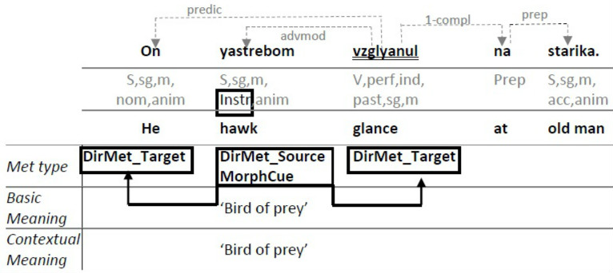
DIRECT METAPHOR
MORPHOLOGICAL CUE
He hawkishly (=fiercely) glanced at the old man.
Notes:
13. Morphological cues are the morphological features that express affinity.
For example, the instrumental construction licensed by the Instrumental Case of a noun is a regular means of expressing resemblance in Russian, as in this sentence.

Slide 14
FACTORS OF METAPHORICITY
CONCRETE ↔ ABSTRACT
NEWLY ATTESTED MEANINGS
METONYMIC SHIFT
SEMANTIC SHIFTS
MORPHOLOGICALLY MOTIVATED FORMS
Notes:
14. Beside Indirect and Direct Metaphor and Personification, we annotate the additional factors of metaphoricity: shift of semantic class of the argument between Concrete and Abstract, metonymic shifts, newly attested meanings, morphologically motivated forms and semantic shifts.

Slide 15

SHIFT OF SEMANTIC CLASS:
CONCRETE ↔ ABSTRACT
This work of art … conquered hearts,
bought freedom.
Notes:
15. Shift of the semantic class of the argument Concrete <-> Abstract: the selectional preference of the contextual meaning (BM or NBM) is restricted to concrete arguments, but takes an abstract argument instead (or vice versa).
E.g. ‘pokupat (V) svobodu (N) – to buy freedom

Slide 16
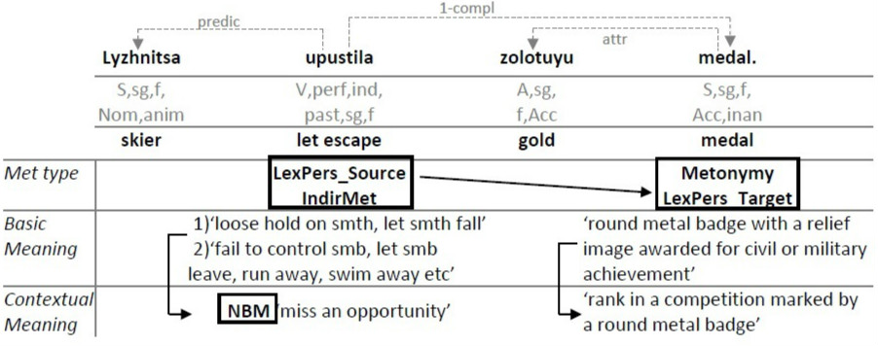
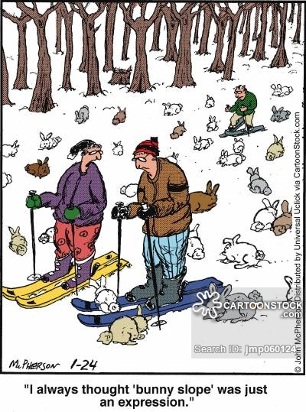
The skier let the gold medal escape.’
METONYMIC SHIFT
Notes:
16. Metonymic shifts: irregular metonymic shifts of any type not attested in the dictionary.
E.g. ‘zolotaya (ADJ) medal (N)’ – gold medal – which stands for a rank in competition.

Slide 17
MORPHOLOGICALLY MOTIVATED FORMS
‘ISCHERPAT’ (V)
NBM ‘deplete, exhaust smth’
NBM ‘use smth up’
NBM ‘complete smth, bring smth to an end’
NBM ‘come to an end, be used up’
‘CHERPAT’ (V)
‘TO SCOOP, EXTRACT LIQUID OR LOOSE SUBSTANCES (USU. FROM BELOW OR DEEP)’
Notes:
17. Morphologically motivated forms
When stem(s) of one word is etymologically connected with the stem of another word which possesses stronger basic meaning(s) than the first word, and this connection is felt by the contemporary speakers the language.
E.g. ‘ischerpat’ (v) has the following dictionary-attested meanings none of which is basic.
NBM ‘expend, exhaust smth’
NBM ‘use smth up’
NBM ‘complete smth, bring smth to an end’
NBM ‘come to an end, be used up’
However, the stem of ‘ischerpat’ is related to the verb of the same stem, ‘cherpat’, which possesses a strongly basic meaning: ‘to scoop, extract liquid or loose substances (usu. from below or deep)’.

Slide 18
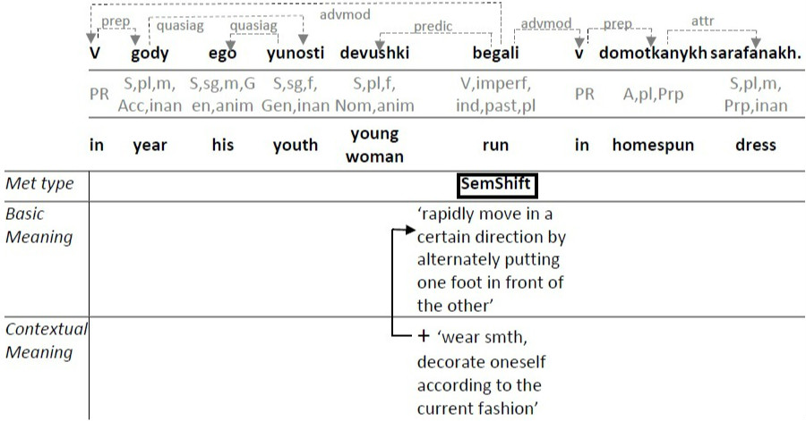

SEMANTIC SHIFT
’In the years of his youth
young women used to run (=wear)
in homespun dresses.
Notes:
18. Semantic shifts.
Non-conventionalized semantic components of a word meaning that are realized in certain constructions.
However, the original semantic content of the source meaning is preserved (unlike in newly attested meanings).
For example, the verb ‘begat’ – run – in this sentence has a tangible additional semantics of ‘wearing’ which is realized by the construction N_{ANIM} V_{’begat’} Prp_{‘v’} _{NTYPE OF CLOTHING}

Slide 19

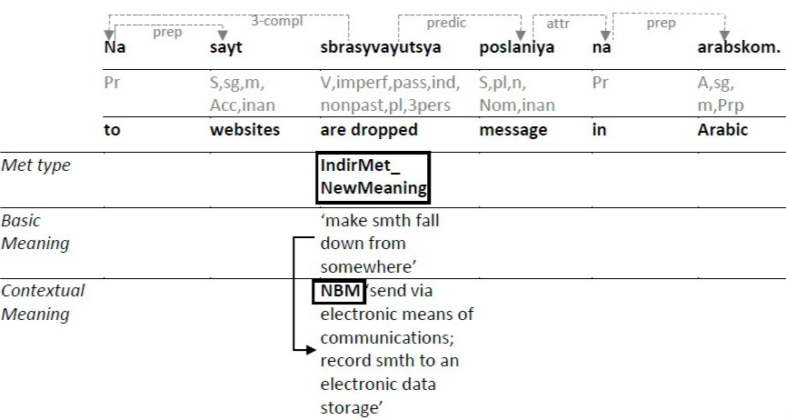
NEWLY ATTESTED MEANINGS
‘Sbrasyvat’ (V) – drop smth
BM ‘make smth fall down from somewhere’
NBM ‘send via electronic means of communications;
record smth to an electronic data storage’
Notes:
19. Newly attested meanings
Secondary meanings that are not attested in the dictionary (including domain-specific terminology, slang etc.). The original semantic content of the source meaning is replaced by the new semantics (to a varying extent).

Slide 20
REFERENCES
Sullivan K. Frames and constructions in metaphoric language. John Benjamins Publishing, 2013. Vol. 14.
Sullivan K. Grammar in metaphor: A construction grammar account of metaphoric language. 2007.
Cameron L. Metaphor in educational discourse. A&C Black, 2003.
Shutova E., Teufel S. Metaphor Corpus Annotated for Source-Target Domain Mappings. // LREC. 2010. Vol. 2. P. 2–2.
Steen G. A Method for Linguistic Metaphor Identification: From MIP to MIPVU. John Benjamins Publishing, 2010. 251 p.
Shutova E., Sun L., Korhonen A. Metaphor identification using verb and noun clustering // Proceedings of the 23rd International Conference on Computational Linguistics. Association for Computational Linguistics, 2010. P. 1002–1010.
Strzalkowski T. et al. Robust extraction of metaphors from novel data // Proceedings of the First Workshop on Metaphor in NLP. 2013. P. 67–76.
Li L., Sporleder C. Using gaussian mixture models to detect figurative language in context // Human Language Technologies: The 2010 Annual Conference of the North American Chapter of the Association for Computational Linguistics. Association for Computational Linguistics, 2010. P. 297–300.
Krishnakumaran S., Zhu X. Hunting elusive metaphors using lexical resources // Proceedings of the Workshop on Computational approaches to Figurative Language. Association for Computational Linguistics, 2007. P. 13–20.
Neuman Y. et al. Metaphor Identification in Large Texts Corpora // PLOS ONE. 2013. Vol. 8, № 4. P. e62343.
Gandy L. et al. Automatic Identification of Conceptual Metaphors With Limited Knowledge. // AAAI. 2013.
SynTagRus: the syntactically annotated corpus of Russian [Electronic resource]. URL: http://www.ruscorpora.ru/instruction-syntax.html.
Boguslavsky I. et al. Development of a Russian Tagged Corpus with Lexical and Functional Annotation // Proceedings of MONDILEX Third Open Workshop. Bratislava, Slovakia, 2009. P. 194.
Dictionary of the Russian Language. 2nd ed. / ed. Yevgenyeva A. Moscow: Academy of Sciences of the USSR; Russian Language Institute, 1981.

Slide 21
ACKNOWLEDGEMENTS
This work is an output of a research project implemented as part of the Basic Research Program at the National Research University Higher School of Economics (HSE).

Slide 22
THANK YOU
Notes:
This presentation is available for download at:

